Slide 1
3. Descriptive Statistics
Describing data with tables and graphs
(quantitative or categorical variables)
Numerical descriptions of center, variability, position (quantitative variables)
Bivariate descriptions (In practice, most studies have several variables)

Slide 2
1. Tables and Graphs
Frequency distribution: Lists possible values of variable and number of times each occurs
Example: Student survey (n = 60) www.stat.ufl.edu/~aa/social/data.html
“political ideology” measured as ordinal variable with 1 = very liberal, …, 4 = moderate, …, 7 = very conservative

Slide 3
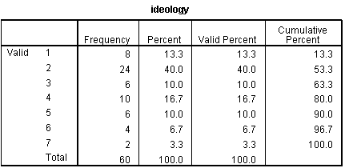

Slide 4
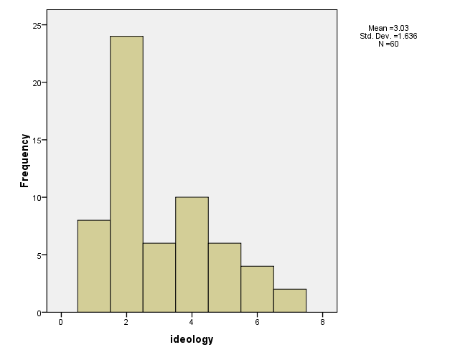
Histogram: Bar graph of frequencies or percentages

Slide 5
Shapes of histograms
(for quantitative variables)
Bell-shaped (IQ, SAT, political ideology in all U.S. )
Skewed right (annual income, no. times arrested)
Skewed left (score on easy exam)
Bimodal (polarized opinions)
Ex. GSS data on sex before marriage in Exercise 3.73: always wrong, almost always wrong, wrong only sometimes, not wrong at all
category counts 238, 79, 157, 409
Notes:
Draw on board, perhaps add U-shaped

Slide 6
Stem-and-leaf plot (John Tukey, 1977)
Example: Exam scores (n = 40 students)
Stem Leaf
3 6
4
5 37
6 235899
7 011346778999
8 00111233568889
9 02238
Notes:
Due to John Tukey, EDA, 1977

Slide 7
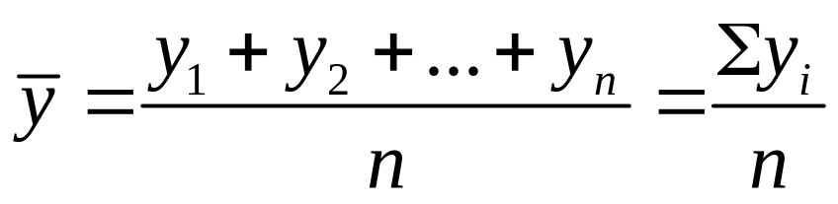
2.Numerical descriptions
Let y denote a quantitative variable, with observations y₁ , y₂ , y₃ , … , y_{n}
a. Describing the center
Median: Middle measurement of ordered sample
Mean:

Slide 8

Example: Annual per capita carbon dioxide emissions (metric tons) for n = 8 largest nations in population size
Bangladesh 0.3, Brazil 1.8, China 2.3, India 1.2, Indonesia 1.4, Pakistan 0.7, Russia 9.9, U.S. 20.1
Ordered sample:
Median =
Mean =
Notes:
Median– average two middle measurements when n even

Slide 9
Example: Annual per capita carbon dioxide emissions (metric tons) for n = 8 largest nations in population size
Bangladesh 0.3, Brazil 1.8, China 2.3, India 1.2, Indonesia 1.4, Pakistan 0.7, Russia 9.9, U.S. 20.1
Ordered sample: 0.3, 0.7, 1.2, 1.4, 1.8, 2.3, 9.9, 20.1
Median =
Mean =
Notes:
Median– average two middle measurements when n even

Slide 10
Example: Annual per capita carbon dioxide emissions (metric tons) for n = 8 largest nations in population size
Bangladesh 0.3, Brazil 1.8, China 2.3, India 1.2, Indonesia 1.4, Pakistan 0.7, Russia 9.9, U.S. 20.1
Ordered sample: 0.3, 0.7, 1.2, 1.4, 1.8, 2.3, 9.9, 20.1
Median = (1.4 + 1.8)/2 = 1.6
Mean = (0.3 + 0.7 + 1.2 + … + 20.1)/8 = 4.7
Notes:
Median– average two middle measurements when n even

Slide 11
Properties of mean and median
For symmetric distributions, mean = median
For skewed distributions, mean is drawn in direction of longer tail, relative to median
Mean valid for interval scales, median for interval or ordinal scales
Mean sensitive to “outliers” (median often preferred for highly skewed distributions)
When distribution symmetric or mildly skewed or discrete with few values, mean preferred because uses numerical values of observations
Notes:
Mean = center of gravity of data. Mode another measure, appropriate for all scales

Slide 12
Examples:
New York Yankees baseball team, 2006
mean salary = $7.0 million
median salary = $2.9 million
How possible? Direction of skew?
Give an example for which you would expect
mean < median

Slide 13
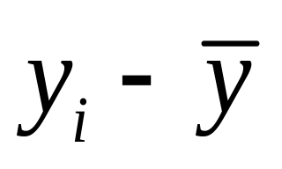
b. Describing variability
Range: Difference between largest and smallest observations
(but highly sensitive to outliers, insensitive to shape)
Standard deviation: A “typical” distance from the mean
The deviation of observation i from the mean is
Notes:
Draw picture showing insensitivity of range to shape

Slide 14
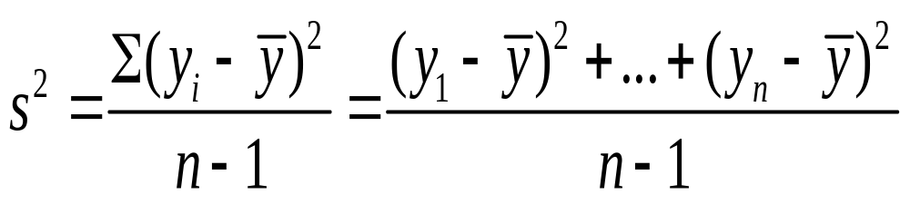

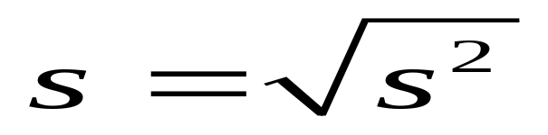
The variance of the n observations is
The standard deviation s is the square root of the variance,

Slide 15
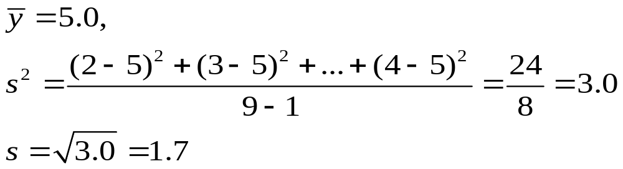
Example: Political ideology
For those in the student sample who attend religious services at least once a week (n = 9 of the 60),
y = 2, 3, 7, 5, 6, 7, 5, 6, 4
For entire sample (n = 60), mean = 3.0, standard deviation = 1.6, tends to have similar variability but be more liberal

Slide 16
Properties of the standard deviation:
  s ≥ 0, and only equals 0 if all observations are equal
  s increases with the amount of variation around the mean
  Division by n - 1 (not n) is due to technical reasons (later)
  s depends on the units of the data (e.g. measure euro vs $)
  Like mean, affected by outliers
  Empirical rule: If distribution is approx. bell-shaped,
  about 68% of data within 1 standard dev. of mean
  about 95% of data within 2 standard dev. of mean
  all or nearly all data within 3 standard dev. of mean

Slide 17
Example: SAT with mean = 500, s = 100
(sketch picture summarizing data)
Example: y = number of close friends you have
GSS: The variable ‘frinum’ has mean 7.4, s = 11.0
Probably highly skewed: right or left?
Empirical rule fails; in fact, median = 5, mode=4
Example: y = selling price of home in Syracuse, NY.
If mean = $130,000, which is realistic?
s = 0, s = 1000, s = 50,000, s = 1,000,000
Notes:
Show picture of SAT

Slide 18
c. Measures of position
p^{th} percentile: p percent of observations below it, (100 - p)% above it.
p = 50: median
p = 25: lower quartile (LQ)
p = 75: upper quartile (UQ)
Interquartile range IQR = UQ - LQ
Notes:
Draw picture

Slide 19
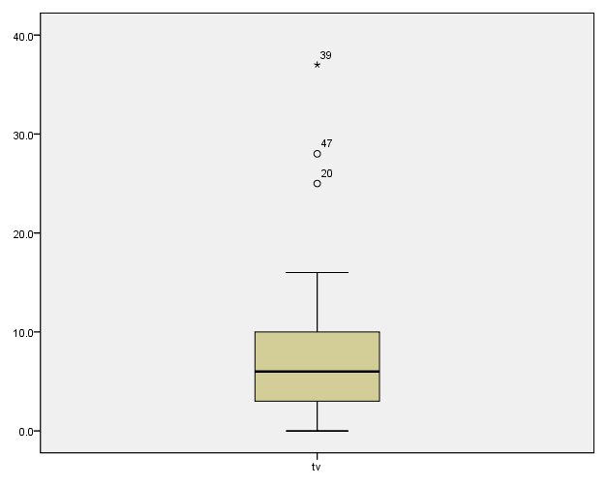
Quartiles portrayed graphically by box plots
(John Tukey)
Example: weekly TV watching for n=60 from student survey data file, 3 outliers

Slide 20
Box plots have box from LQ to UQ, with median marked. They portray a five-number summary of the data:
Minimum, LQ, Median, UQ, Maximum
except for outliers identified separately
Outlier = observation falling
below LQ – 1.5(IQR)
or above UQ + 1.5(IQR)
Ex. If LQ = 2, UQ = 10, then IQR = 8 and outliers above 10 + 1.5(8) = 22

Slide 21
3. Bivariate description
Usually we want to study associations between two or more variables (e.g., how does number of close friends depend on gender, income, education, age, working status, rural/urban, religiosity…)
Response variable: the outcome variable
Explanatory variable(s): defines groups to compare
Ex.: number of close friends is a response variable, while gender, income, … are explanatory variables
Response var. also called “dependent variable”
Explanatory var. also called “independent variable”

Slide 22
Summarizing associations:
Categorical var’s: show data using contingency tables
Quantitative var’s: show data using scatterplots
Mixture of categorical var. and quantitative var. (e.g., number of close friends and gender) can give numerical summaries (mean, standard deviation) or side-by-side box plots for the groups
Ex. General Social Survey (GSS) data
Men: mean = 7.0, s = 8.4
Women: mean = 5.9, s = 6.0
Shape? Inference questions for later chapters?

Slide 23
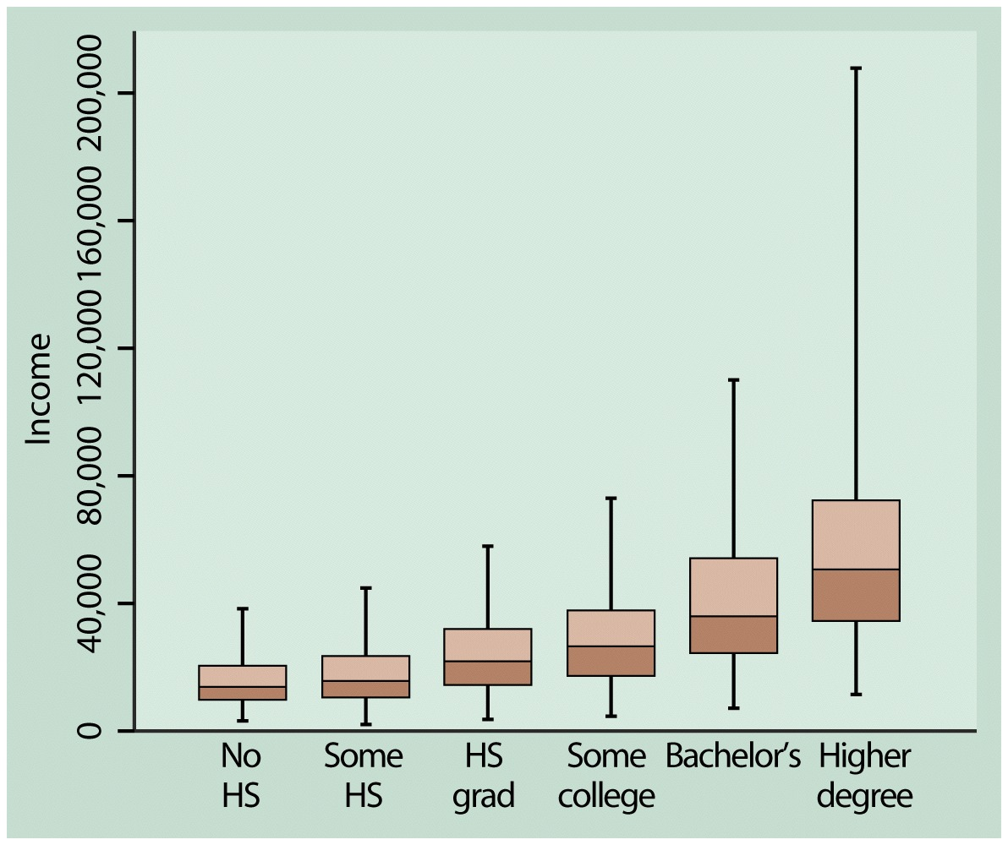
Example: Income by highest degree

Slide 24
Contingency Tables
Cross classifications of categorical variables in which rows (typically) represent categories of explanatory variable and columns represent categories of response variable.
Counts in “cells” of the table give the numbers of individuals at the corresponding combination of levels of the two variables

Slide 25
Happiness and Family Income
(GSS 2008 data: “happy,” “finrela”)
Happiness
Income Very Pretty Not too Total
-------------------------------
Above Aver. 164 233 26 423
Average 293 473 117 883
Below Aver. 132 383 172 687
------------------------------
Total 589 1089 315 1993

Slide 26
Can summarize by percentages on response variable (happiness)
Example: Percentage “very happy” is
39% for above aver. income (164/423 = 0.39)
33% for average income (293/883 = 0.33)
19% for below average income (??)

Slide 27
Happiness
Income Very Pretty Not too Total
--------------------------------------------
Above 164 (39%) 233 (55%) 26 (6%) 423
Average 293 (33%) 473 (54%) 117 (13%) 883
Below 132 (19%) 383 (56%) 172 (25%) 687
----------------------------------------------
Inference questions for later chapters? (i.e., what can we conclude about the corresponding population?)

Slide 28
Scatterplots (for quantitative variables)
plot response variable on vertical axis,
explanatory variable on horizontal axis
Example: Table 9.13 (p. 294) shows UN data for several nations on many variables, including fertility (births per woman), contraceptive use, literacy, female economic activity, per capita gross domestic product (GDP), cell-phone use, CO2 emissions
Data available at http://www.stat.ufl.edu/~aa/social/data.html

Slide 29
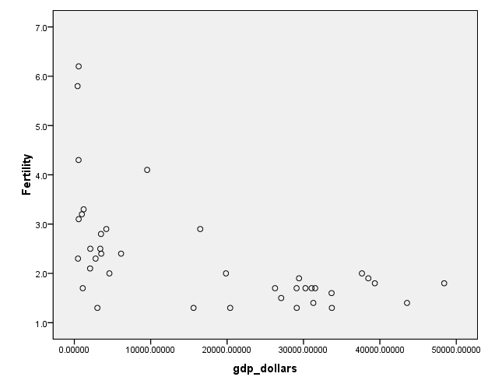

Slide 30
Example: Survey in Alachua County, Florida, on predictors of mental health
(data for n = 40 on p. 327 of text and at www.stat.ufl.edu/~aa/social/data.html)
y = measure of mental impairment (incorporates various dimensions of psychiatric symptoms, including aspects of depression and anxiety)
(min = 17, max = 41, mean = 27, s = 5)
x = life events score (events range from severe personal disruptions such as death in family, extramarital affair, to less severe events such as new job, birth of child, moving)
(min = 3, max = 97, mean = 44, s = 23)

Slide 31
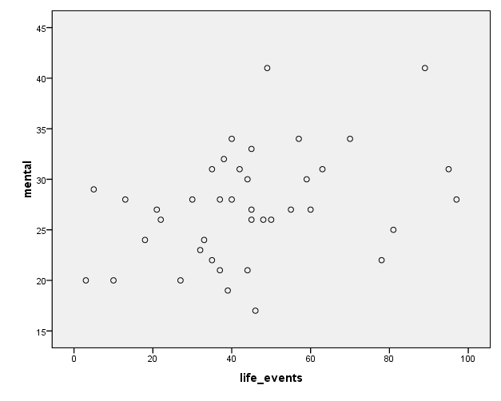

Slide 32
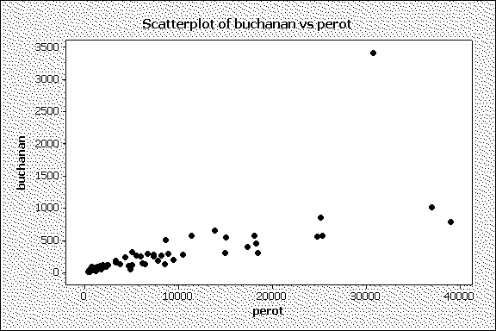
Bivariate data from 2000 Presidential election
Butterfly ballot, Palm Beach County, FL, text p.290

Slide 33
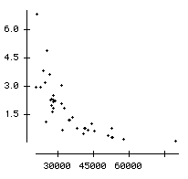
Example: The Massachusetts Lottery
(data for 37 communities)
% income spent on lottery
Per capita income

Slide 34
Correlation describes strength of association
Falls between -1 and +1, with sign indicating direction of association (formula later in Chapter 9)
The larger the correlation in absolute value, the stronger the association (in terms of a straight line trend)
Examples: (positive or negative, how strong?)
Mental impairment and life events, correlation =
GDP and fertility, correlation =
GDP and percent using Internet, correlation =

Slide 35
Correlation describes strength of association
Falls between -1 and +1, with sign indicating direction of association
Examples: (positive or negative, how strong?)
Mental impairment and life events, correlation = 0.37
GDP and fertility, correlation = - 0.56
GDP and percent using Internet, correlation = 0.89

Slide 36
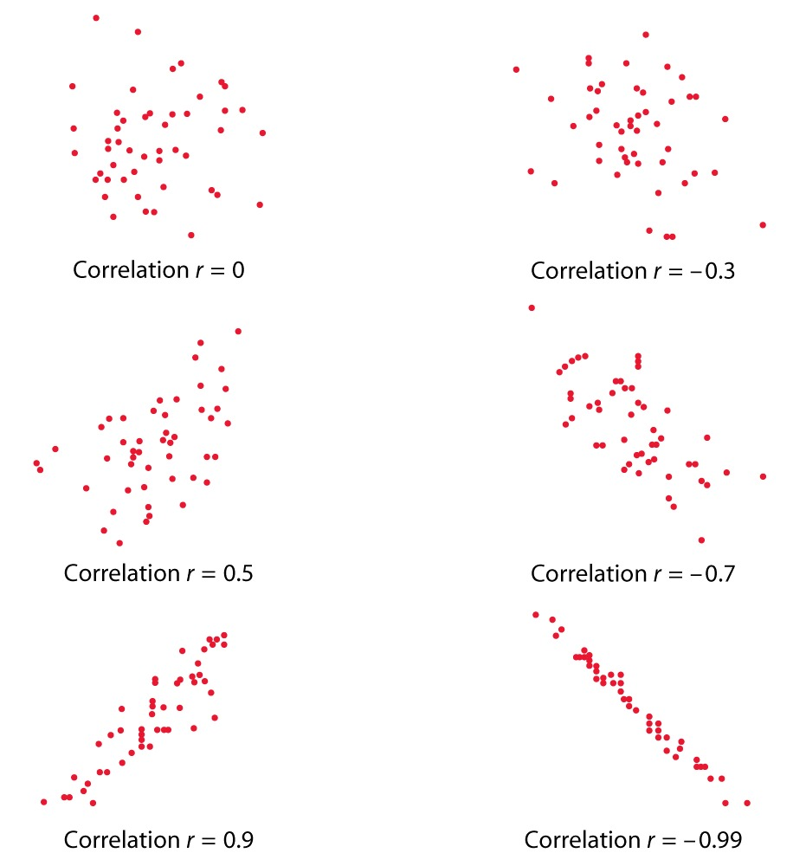

Slide 37
Regression analysis gives line predicting y using x
Example:
y = mental impairment, x = life events
Predicted y = 23.3 + 0.09x
e.g., at x = 0, predicted y =
at x = 100, predicted y =

Slide 38
Regression analysis gives line predicting y using x
Example:
y = mental impairment, x = life events
Predicted y = 23.3 + 0.09x
e.g., at x = 0, predicted y = 23.3
at x = 100, predicted y = 23.3 + 0.09(100) = 32.3
Inference questions for later chapters?
(i.e., what can we conclude about the population?)

Slide 39
Example: student survey y = college GPA, x = high school GPA
(data at www.stat.ufl.edu/~aa/social/data.html)
What is the correlation?
What is the estimated regression equation?
We’ll see later in course the formulas for finding the correlation and the “best fitting” regression equation (with possibly several explanatory variables), but for now, try using software such as SPSS to find the answers.

Slide 40
Sample statistics /
Population parameters
We distinguish between summaries of samples (statistics) and summaries of populations (parameters).
Common to denote statistics by Roman letters, parameters by Greek letters:
Population mean =μ, standard deviation = σ,
proportion  are parameters.
In practice, parameter values unknown, we make inferences about their values using sample statistics.

Slide 41
The sample mean estimates
the population mean μ (quantitative variable)
The sample standard deviation s estimates
the population standard deviation σ (quantitative variable)
A sample proportion p estimates
a population proportion  (categorical variable)

